Slide 1
DATA SCIENCE Project
By Nave Shimoni & Itay Galili

Slide 2
TABLE OF CONTENTS
01
04
02
05
03
06
Introduction & Research Question
EDA & Visualization
Crawling
Machine Learning
Summary & Conclusions
Data Handling

Slide 3
01
Introduction & Research Question

Slide 4
Introduction & Research Question
As car dealers, we want to buy a car and use it for rent, eventually sell the car at a price as close as possible to the original price. Therefore, our research question is:
What will be the decrease in car's value in X years?
In order to answer this question, we used the information from the website:
ZapCars (https://www.zapcars.co.il/).

Slide 5
02
Crawling

Slide 6
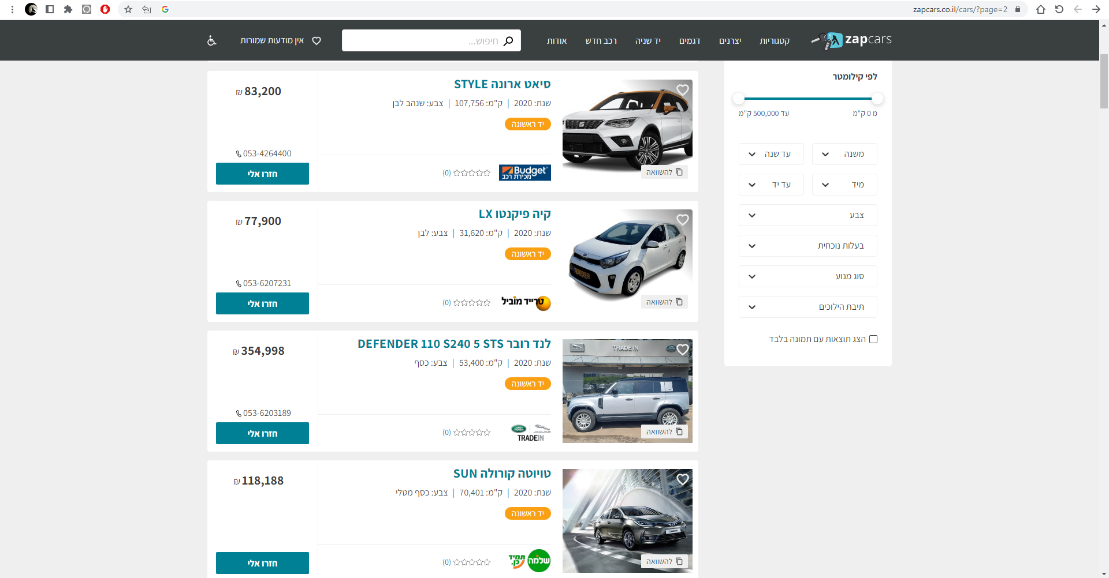
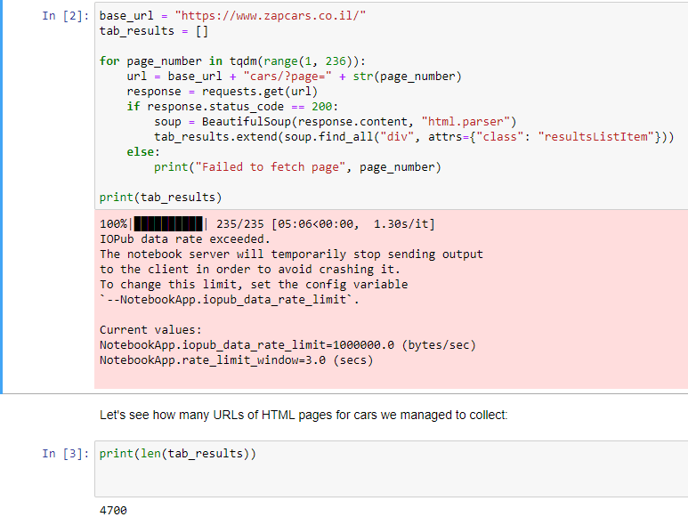
Crawling
In testing before the crawling, we saw that there are about 4700 cars, each HTML page on the site contains 20 cars, so about 235 iterations are required for each page, in addition we saw that the difference between pages is its URL extension.

Slide 7
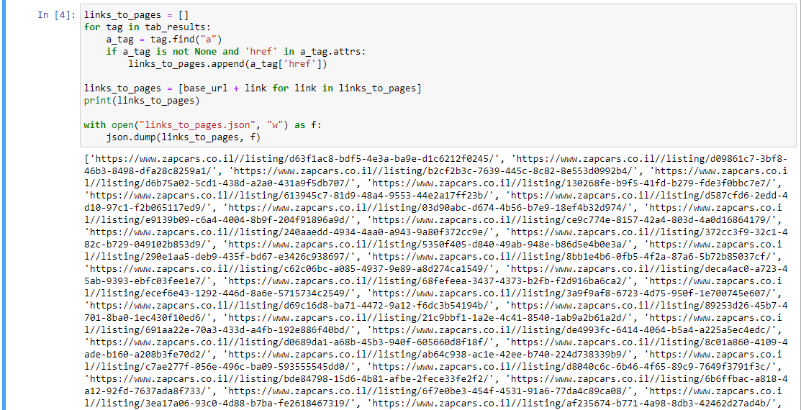
Crawling
Notes:
גם פה לכל כתובת של רכב יש את הכתובת הבסיסית פלוס תוספת ייחודית לכל רכב

Slide 8
Crawling
Once we have received all the addresses of each page, we will go through each page and take the relevant information from it. We saw that there are 12 columns of information that can be a component of a car price.
We decided to perform health checks on the resulting elements at this stage (element type, end cases, transfer from string to int, etc.).
We used 'tqdm' to control the workflow (which took almost an hour).

Slide 9
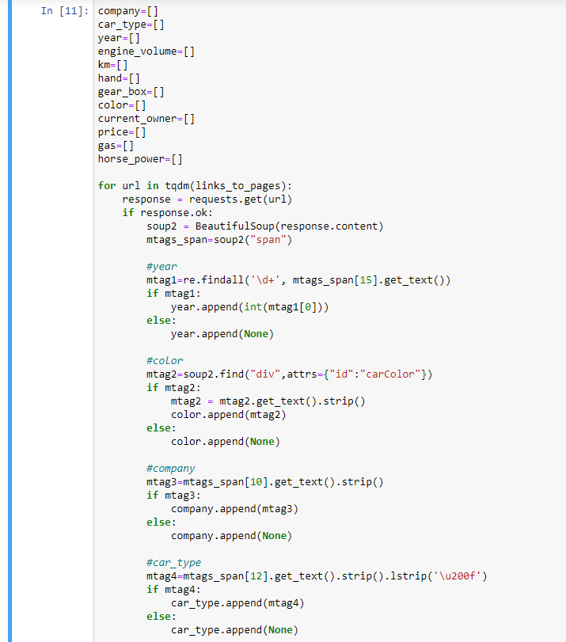
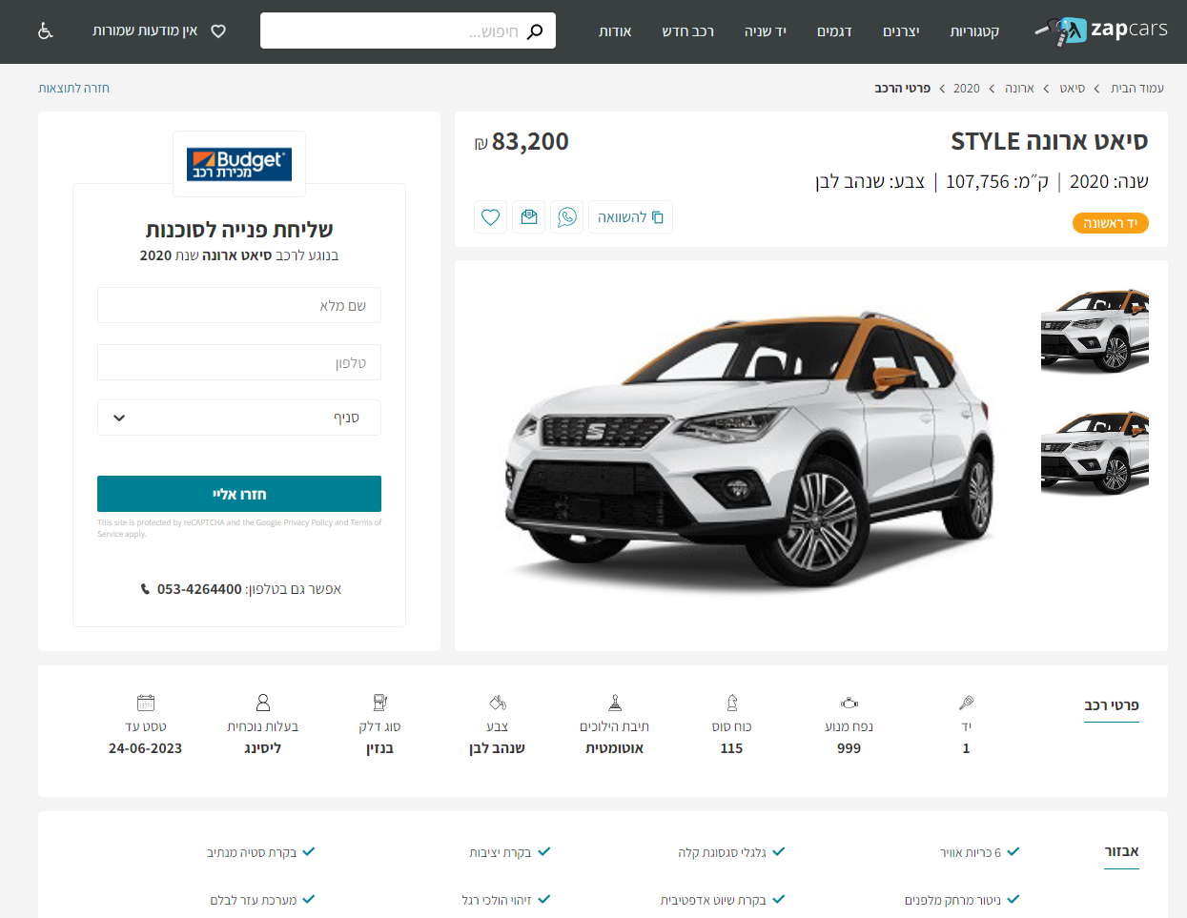
Crawling
Notes:
גם פה לכל כתובת של רכב יש את הכתובת הבסיסית פלוס תוספת ייחודית לכל רכב

Slide 10
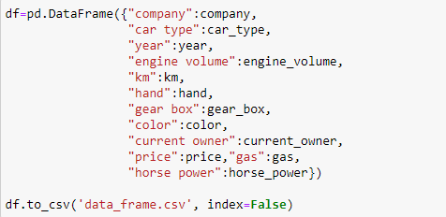
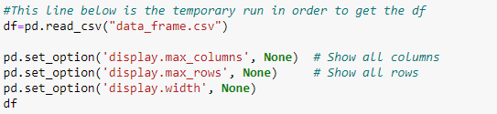
Crawling
We got a data frame with 12 columns and 4699 rows, in total we have 56,400 data units. We will save everything on a CSV file for use at other times.
Notes:
גם פה לכל כתובת של רכב יש את הכתובת הבסיסית פלוס תוספת ייחודית לכל רכב

Slide 11
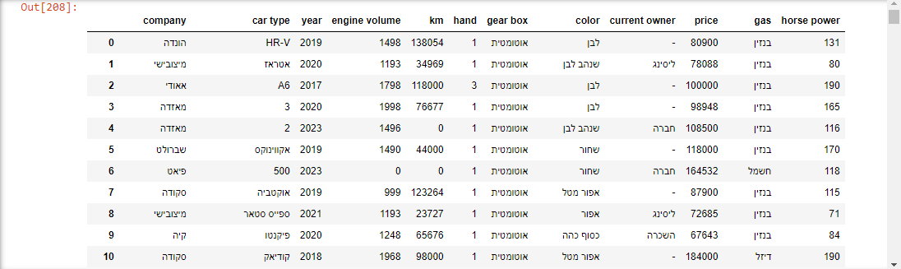
Crawling
Notes:
גם פה לכל כתובת של רכב יש את הכתובת הבסיסית פלוס תוספת ייחודית לכל רכב

Slide 12
03
Data Handling

Slide 13
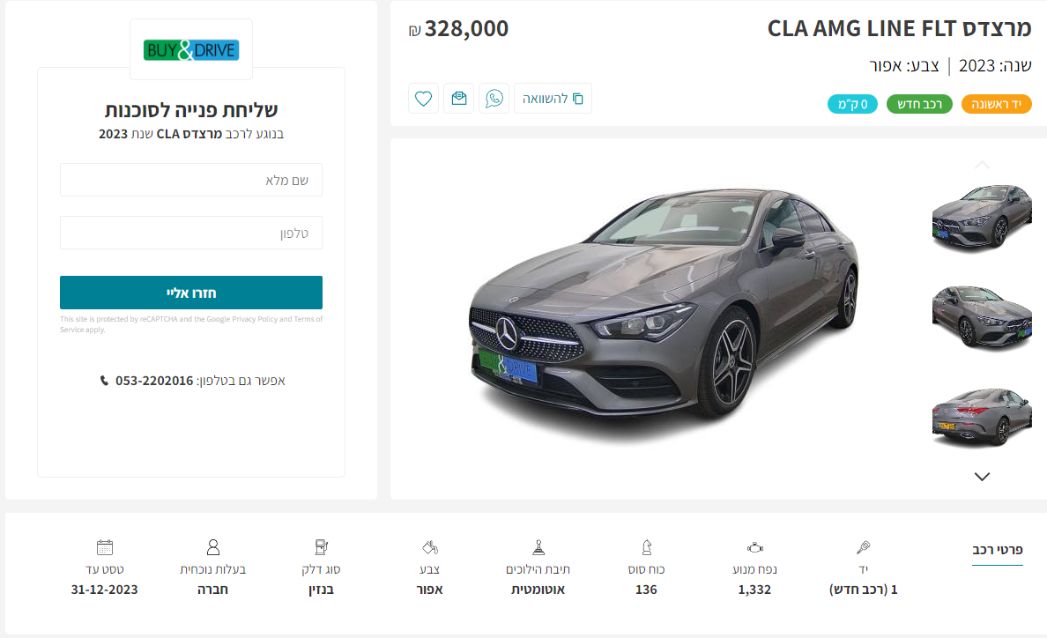
Data Handling
Reminder: These are the treatments that have already been performed:
Any element that has no data - we put "None" instead.
We saw that new cars do not indicate the vehicle's km, so we proactively put 0.
We performed casting on strings and turned them into int.

Slide 14
Data Handling
Firstly, we started with simple data verification commands, such as: df.describe(), df.info(), df.isnull.sum(). After we got the initial information about our data, we started to handle it in depth:
Changed the names of companies and car’s type to English
Filled null cells
Changed category features into numeric
Normalized numeric features, such as price and km
Removed duplicates rows
Eventually, we got the final data frame with 12 columns and 4591 rows,
total of 55,092 data units.

Slide 15
04
EDA & Visualization

Slide 16
EDA & Visualization
With the help of visualization, we came to conclusions about our data that we did not necessarily know before and in addition we could also see the effect of a certain characteristic on the other.
Since we had a very wide number of companies and it was difficult to present them all, we defined that any company we collected with less than 40 vehicles was defined as "other“.

Slide 17
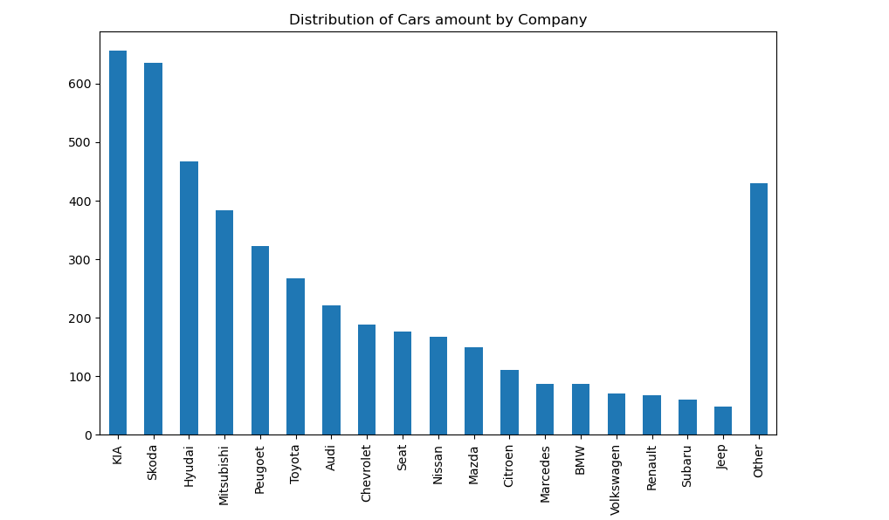
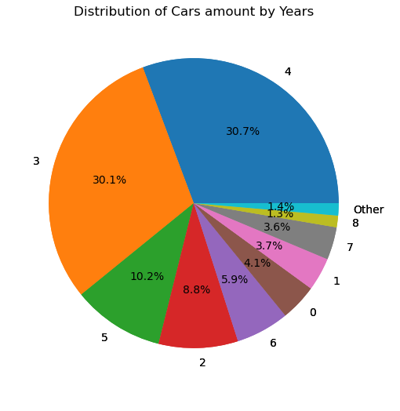
One dimensional visualizations

Slide 18
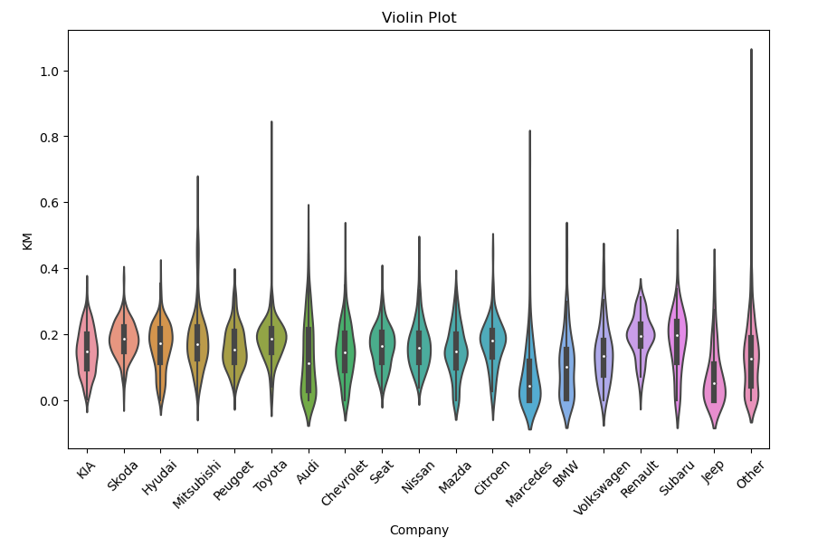
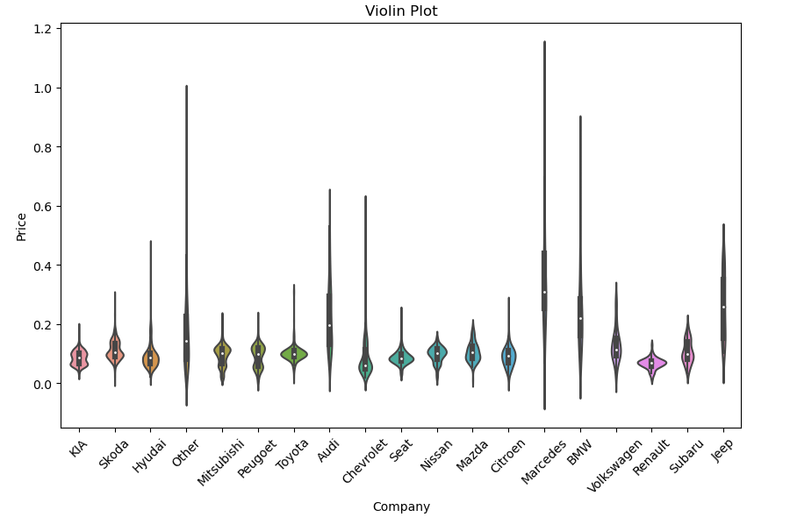
One dimensional visualizations

Slide 19
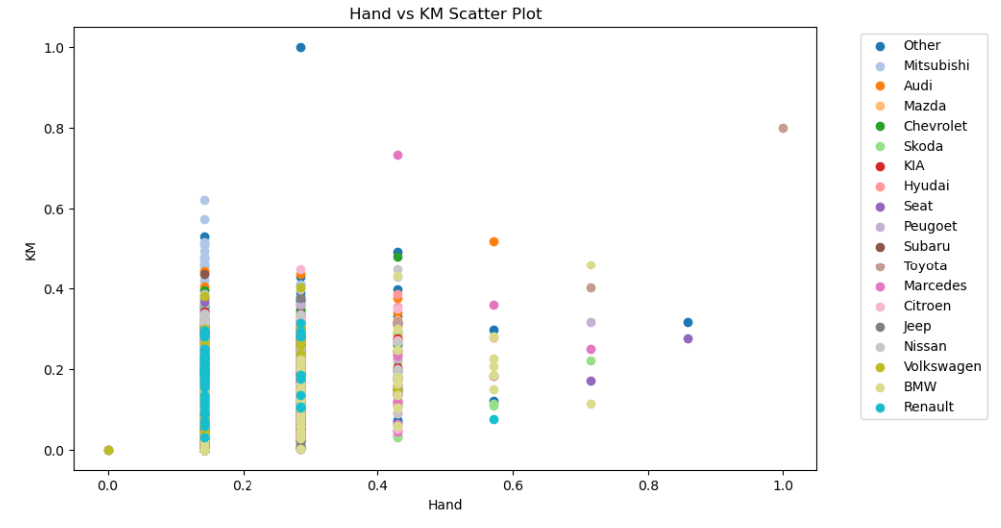
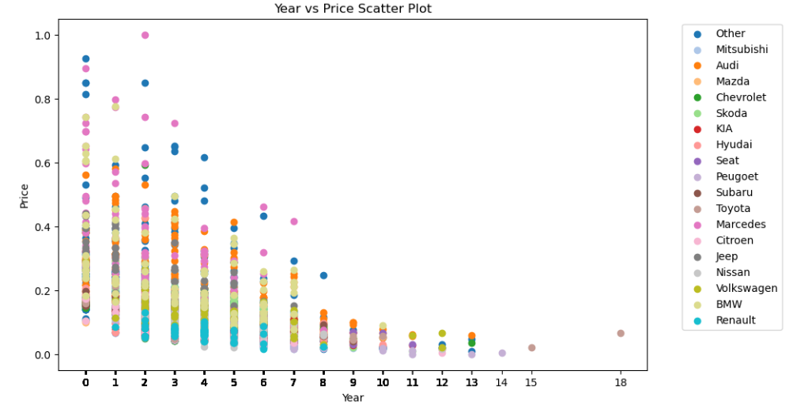
Two dimensional visualizations

Slide 20
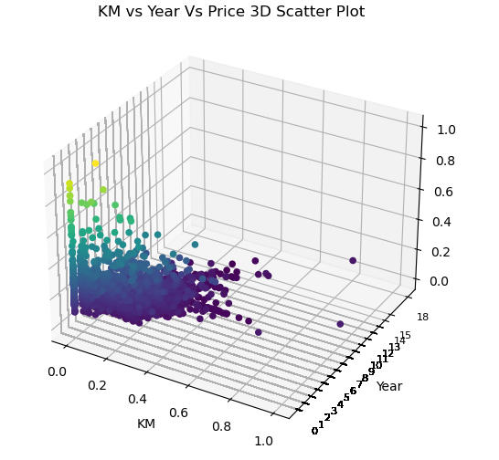
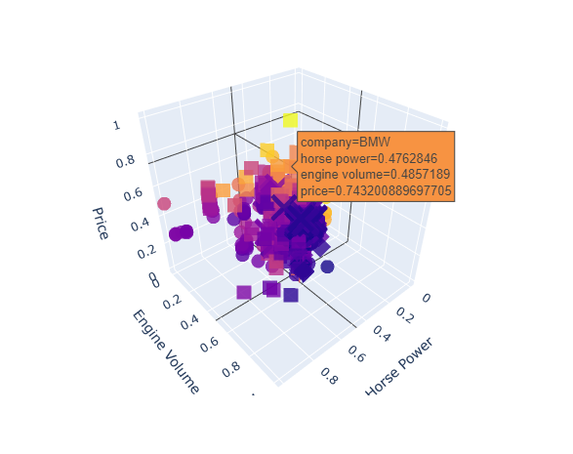
Multi dimensional visualizations

Slide 21
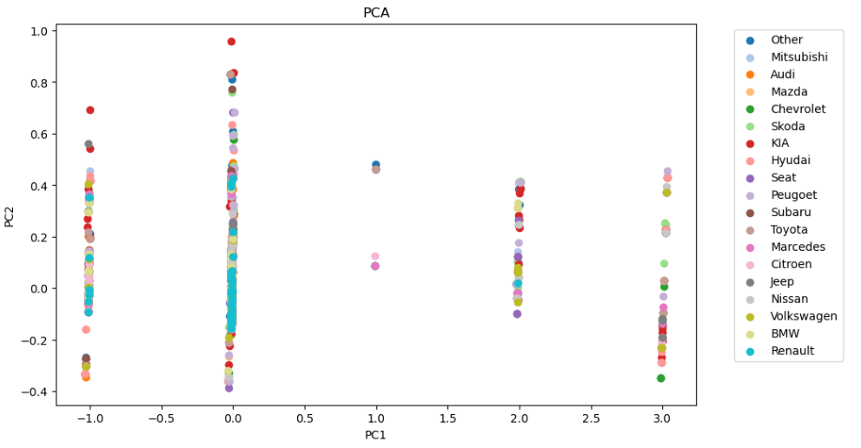
Multi dimensional visualizations
5 features 2 features

Slide 22
05
Machine Learning

Slide 23
Machine Learning
Since our research question is a supervised learning problem and we also want to predict a continuous numerical value, we used linear regression, and we tried several methods in order to get the highest value for R².
Univariate regression
R² score < 20%
Multivariate regression
R² score = 66%
Feature engineering (Polynomial regression with degree=2)
R² score = 76%
Grid search (Polynomial regression with degree=3)
R² score = 79%

Slide 24
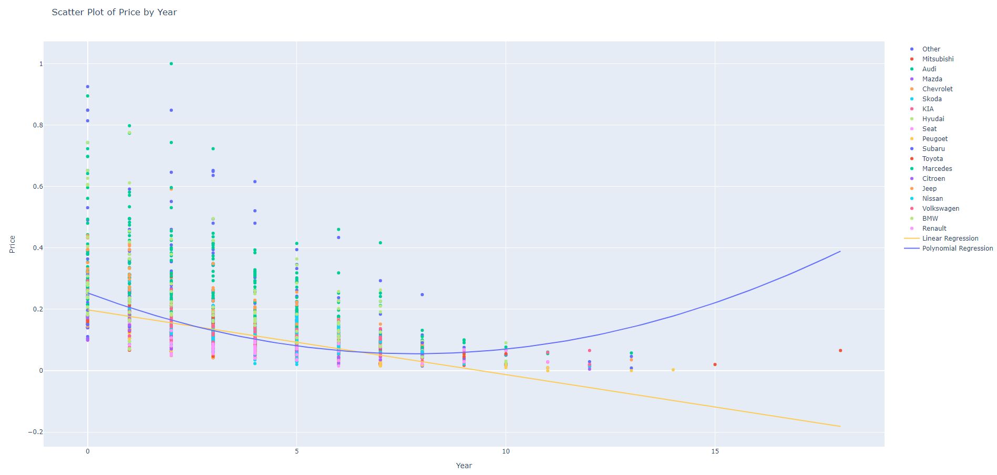
Machine Learning
Univariate regression
R² score < 20%

Slide 25
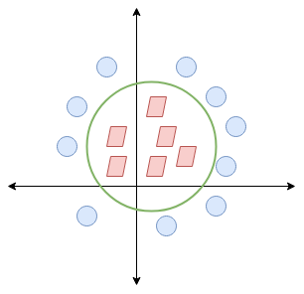
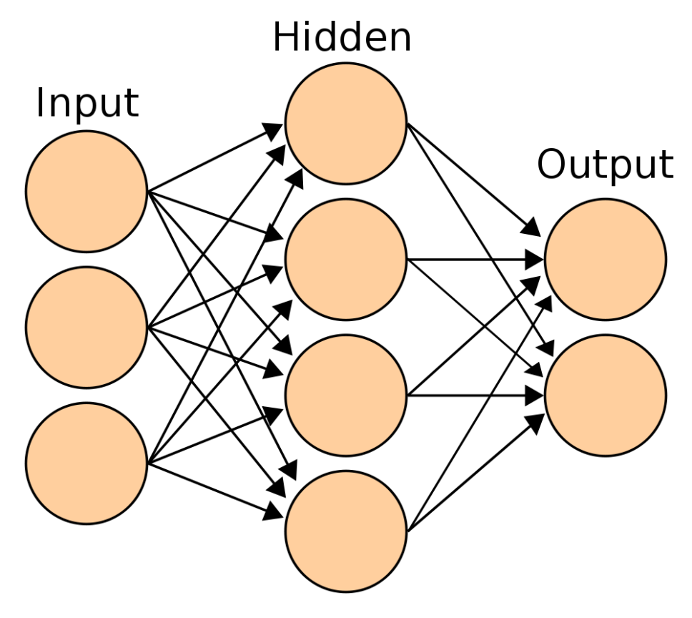
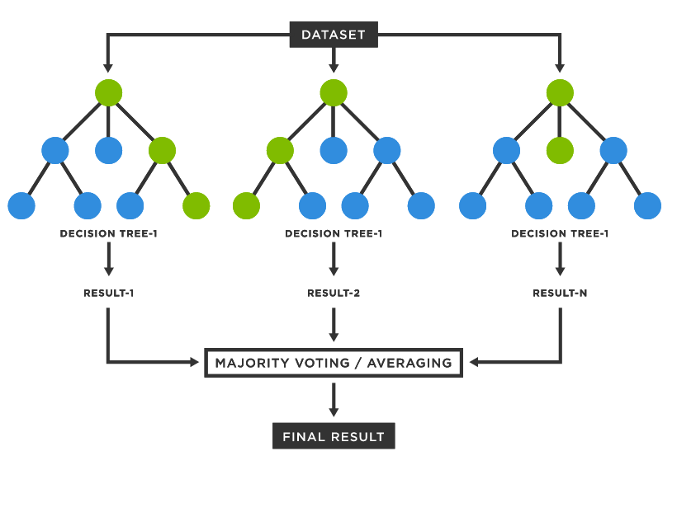
Machine Learning
We tried additional algorithms to determine if we could achieve a better R² score.
SVR
MLP
Random Forest
R² score = 63%
R² score = 74%
R² score = 89%

Slide 26
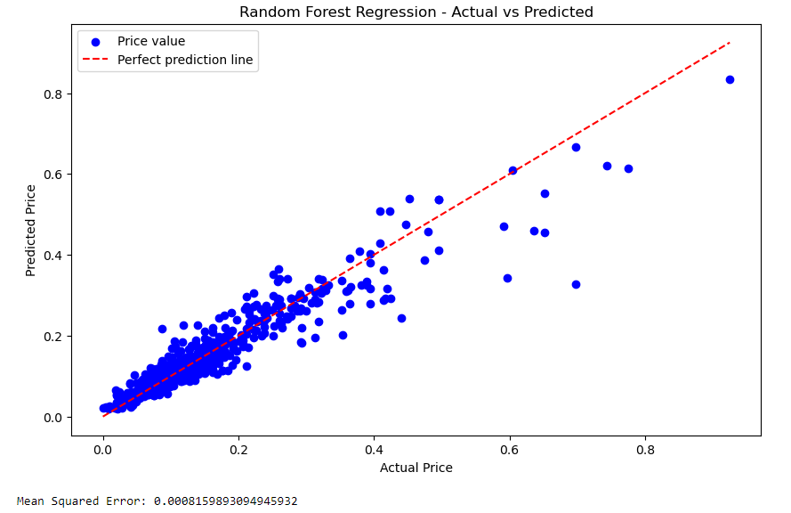
Machine Learning
Since the price variable is between 0 and 1, the MSE value of 0.0008159893094945932 can be considered relatively small. It suggests that, on average, the predicted prices are very close to the actual prices, given the scale of the target variable.

Slide 27
06
Summary & Conclusions

Slide 28
Summary & Conclusions
It seems that in order to get a model with the highest R² score, we must consider all the car’s features in our X matrix.
After all the tests and improvements we made, the best model for us is “Random Forest” with 89% R² score.

Slide 29

THANKS FOR WATCHING

Slide 30

THANKS
Do you have any questions?
youremail@freepik.com
+91 620 421 838
yourwebsite.com
Please keep this slide for attribution

